Slide 1



</coding>
Gavin McClary
Senior Lecturer

Slide 2

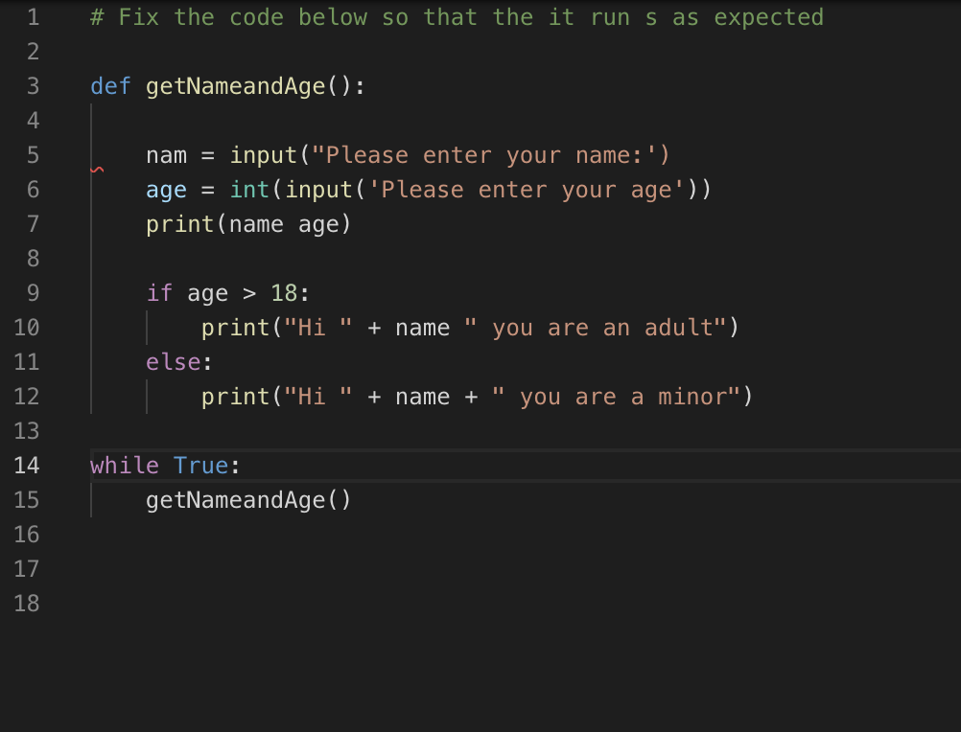
5 things wrong with this code

Slide 3
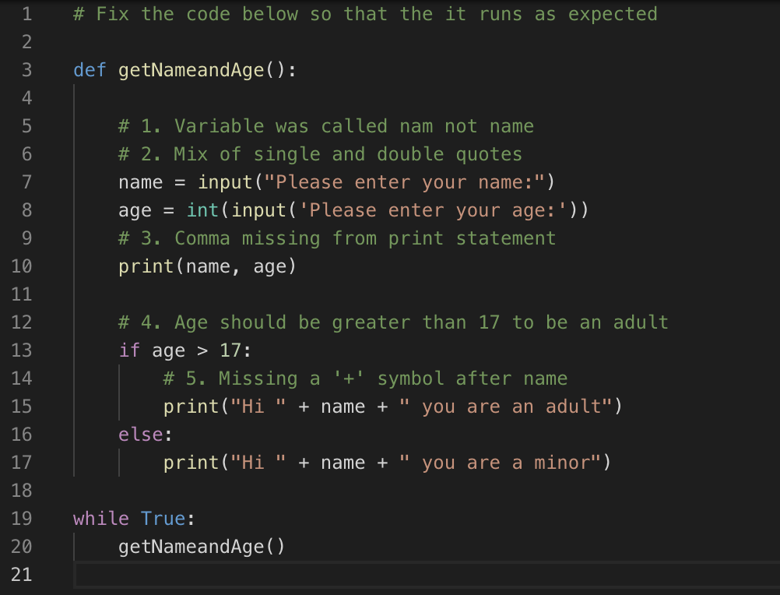
Solution

Slide 4





5 new things in the solution?
A Python function definition
An if statement
An else statement
A while loop
A function call

Slide 5
What will you learn?
Functions – What they are and why use them
If/elif/else statements – What they are and why use them
While/for loops - What they are and why use them

Slide 6


Control flow
Control flow is the order in which the program’s code executes. Examples in Python are function calls, conditional statements and loops.

Slide 7

Control flow: Functions
A function is a block of organized, reusable code with the purpose of providing modularity and increased code reuse in your application.
print() is a Python built-in function.
Different programming languages refer to them differently e.g.
methods
sub-routines
procedures

Slide 8
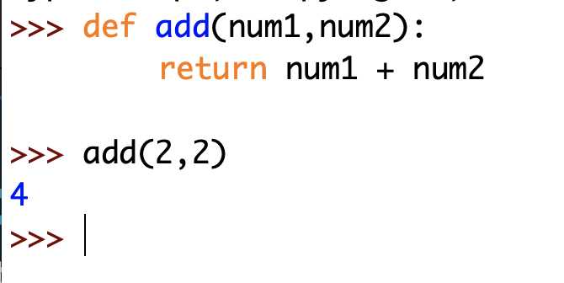
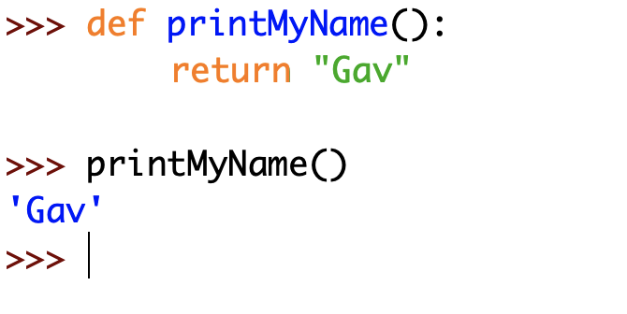
Function definition
To define a function we use the def keyword followed by the function name.
If we want to pass arguments to the function we need to state these in
between parentheses, separated by a comma.
Many times but not always a function ends with a return statement.
When calling the function we need to provide arguments in parentheses or we will receive an error.
If the function has no arguments then we do not need to provide them when calling the function.

Slide 9
Back to our Solution
The function definition.
The function call.

Slide 10
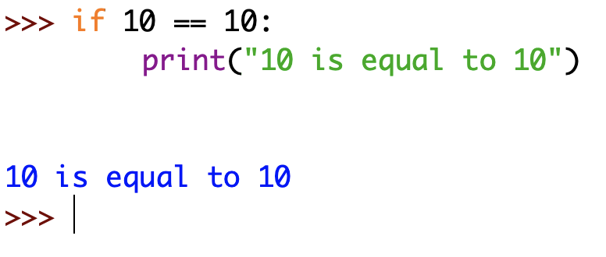
Control flow: If/elif/else
It is common to need to execute some code statements only if a certain condition is met. For example if making a Password Checker program you would need to check if the password entered either matched or did not match the correct password.
The Python compound statement if, which uses if, elif, and else clauses, lets you conditionally execute blocks of code statements depending on the outcome..

Slide 11
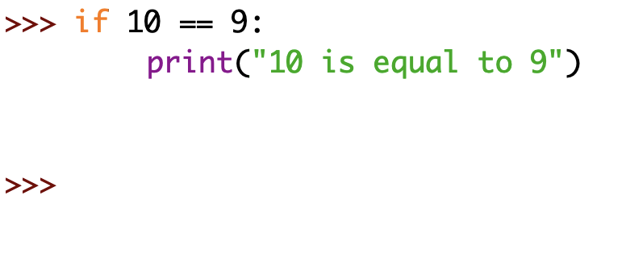
If statement
The statement after if keyword is evaluated, in this case: is 10 == 10?.
If it evaluates to True then the code indented below is executed.
If it evaluates to False then the code indented below is NOT executed.

Slide 12
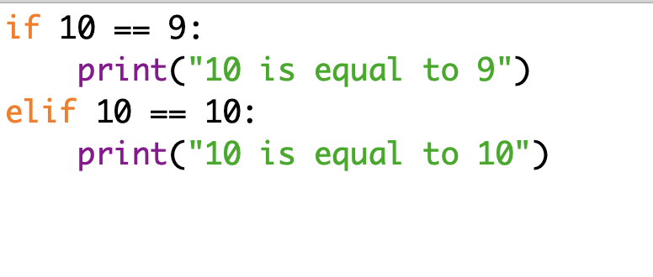
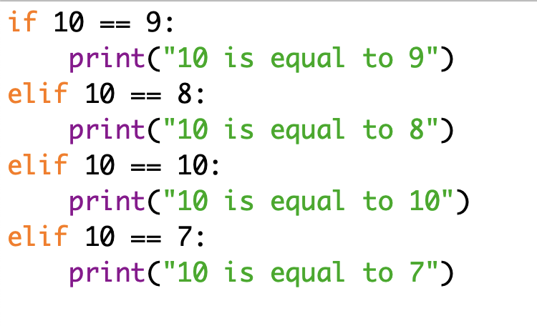
Elif statement
Adding an elif statement means if the if statement evaluates to False Python will move to the elif statement and evaluate that. If True then the indented code will run.
We can have multiple elif statements.

Slide 13
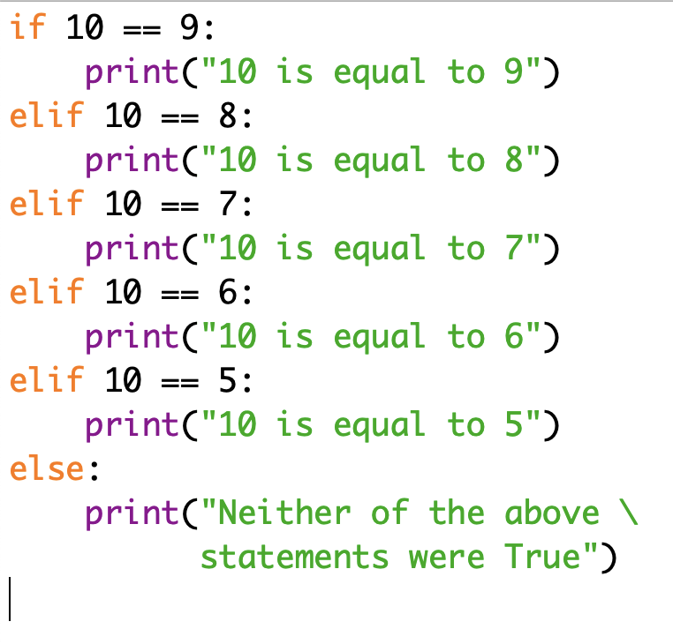
Else statement
What if none of our statements evaluate to True?
Well, we have the else statement.
Else will mop-up at the end of your if/elif/else block if none of your statements evaluate to True.

Slide 14
Challenge:
Password checker
Requirements
Must be commented (both single line comments and multi-line comments)
Must accept user name as input (include a prompt)
Must accept password as input (include a prompt)
Must use if condition to check if password is correct
If password is correct print out something e.g. “Password is correct!”
If password is incorrect print out something e.g. “Password is incorrect!”

Slide 15
Control flow: Loops (While and for)
The while statement in Python supports repeated execution of a statement or block of statements that is controlled by a conditional expression.

Slide 16
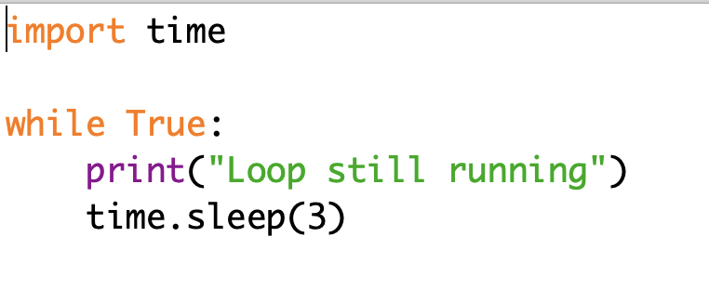
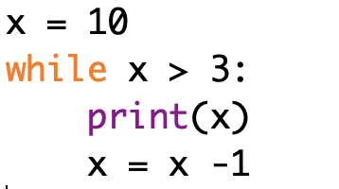
While loop
A while loop can be used to continue to run code statements for as long as the condition is True.
A common use of a while loop is to keep a program running indefinitely.
A while loop can also have a conditional statement.

Slide 17
Back to our Solution
The while True loop keeps calling the function over and over again.

Slide 18
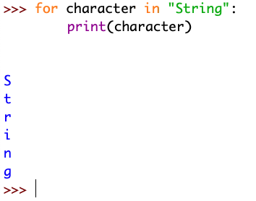
For loop
You can iterate (loop) through different items using a for loop.
In this example we loop through the string “String” and print the next letter every time we go through the loop.

Slide 19
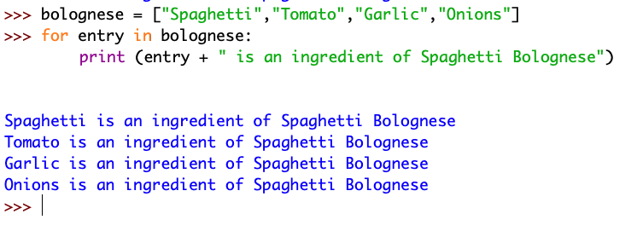
Another example…

Slide 20
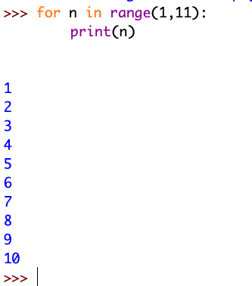
Another example…
Here we use the range() function that generates numbers using start and stop values.
In this example the start value is 1 and the stop value is 11.
This prints a list of numbers from 1 to 10.

Slide 21
Challenge:
Python Exercises
Go to: https://www.w3schools.com/python/python_exercises.asp
There are 51 exercises to test your Python skills so far.

Slide 22
What have you learned?
Functions – What they are and why use them
If/elif/else statements – What they are and why use them
While/for loops - What they are and why use them

Slide 23

Next Steps
Coding103 – Part 3 (of course!)
Free online resources:
www.codeacademy.com
www.sololearn.com
https://realpython.com
https://automatetheboringstuff.com

Slide 24
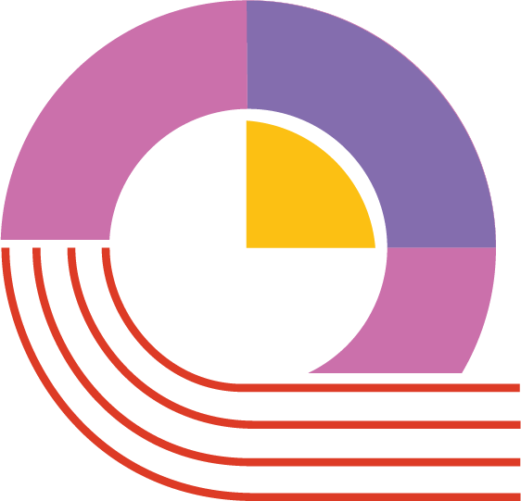
Your feedback

